Slide 1
Crash FullStack Programming Website
From zero to hero
2020

Slide 2
Week 1 – Introduction Web Development

Slide 3
Present By Alif Razan Saputra

Slide 4
What is Web Development
Web development is the work involved in developing a Web site for the Internet (World Wide Web) or an intranet (a private network).
Example
- E Commerce
- Web engineering,
- Web design
- And so on.

Slide 5
Istilah – istilah
WS : Web Service
FE : FrontEnd
BE : BackEnd
UI : UserInterface
UX : UserExperience
MB : MobileDev
System Analyst

Slide 6
Field of work for programmers
WS
Web Service : Bekerja untuk Menghubungkan Aplikasi utama dengan aplikasi lain
Contoh : aplikasi Tokopedia dengan system pembayaran bank (virtual Account)

Slide 7
Field of work for programmers
FE
FrontEnd :Bekerja untuk membuat Front Page atau bisa dibilang tampilan webpage + functionalitynya yang diperuntukan untuk user
Contoh : www.tokopedia.com

Slide 8
Field of work for programmers
BE
BackEnd :Bekerja untuk membuat Front Page atau bisa dibilang tampilan webpage + functionalitynya yang diperuntukan untuk Admin
Contoh : jarang diketahui tapi ada, hanya perusahaan yang tahu

Slide 9
Field of work for programmers
UI
UserInterface :Bekerja untuk membuat tampilan yang di rancang oleh designer menjadi tampilan website static
Contoh : template css

Slide 10
Field of work for programmers
UX
UserExperience : hamper sama dengan UI, namun ia lebih ke tataletaknya. Kalau ibarat teknik sipil dia adalah arsiteknya, UI adalah Kulinya
Contoh : entah?

Slide 11
Field of work for programmers
MB
Mobile Development: Programer Mobile
Contoh : ionic, flutter, Kotlin, React Native

Slide 12
Field of work for programmers
System Analyst
Bekerja menganalisa project, yah lebih ke ini lah.
Contoh : project Manajer

Slide 13



Choose your Character – Local Server

Slide 14





Choose your Character – Cloud Server

Slide 15








Choose your Character – Database
SQL
NoSQL

Slide 16








Choose your Character – Native Language
BackEnd
Bahasa native/engine:
Mobile
Bahasa native:
UI
Bahasa native:

Slide 17





Choose your Character – Text Editor

Slide 18




Choose your Character – FrameWork BackEnd PHP

Slide 19





Choose your Character – FrameWork CSS

Slide 20







Choose your Character – FrameWork BackEnd JavaScript

Slide 21



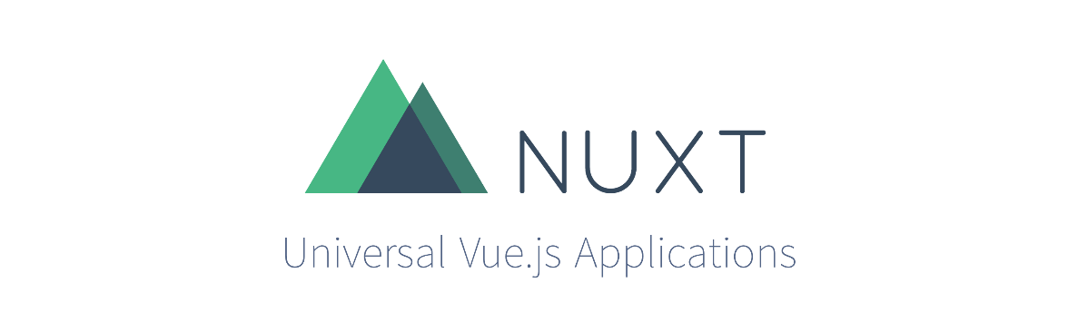

Choose your Character – FrameWork FrontEnd JavaScript

Slide 22






Choose your Character – Mobile FrameWork

Slide 23



Choose your Character – Penyimpanan Kodingan

Slide 24
Studi Kasus yang akan dibuat
Aplikasi CV online

Slide 25



Teknologi yang digunakan (1)
Lokal server
Database
FrontEnd
BackEnd
Webservice
Design

Slide 26

Teknologi yang digunakan (1)
Mobile
Text Editor
Cloud Server
Push Notif

Slide 27
More detailed examples
Name Products / Company | Application | Basic Concept | Business Proccess
TokoPedia | Website, Mobile App, API | E Commerce | C2C
Lazada | Website, Mobile App | E Commerce | C2C
Grab | Mobile App | Public Transportation | B2C
Gojek | Mobile App | Public Transportation | B2C

Slide 28



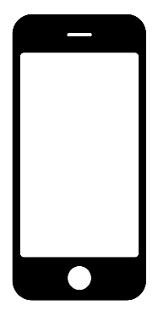

They have minimum requirement to be
In Case
WS Could be
- Verification OTP
- Payment
- BackEnd
- Queue
Cloud [WS]
Cloud [WS]
Cloud [WS]
Database
Micro Service

Slide 29
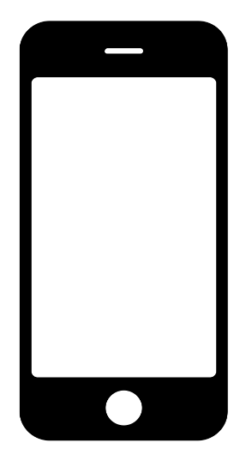

How They Works?
Pulling userdata and bring it back
Database
Example : Login Proccess
Verify Username Password
Cloud
Username & Password are send

Slide 30
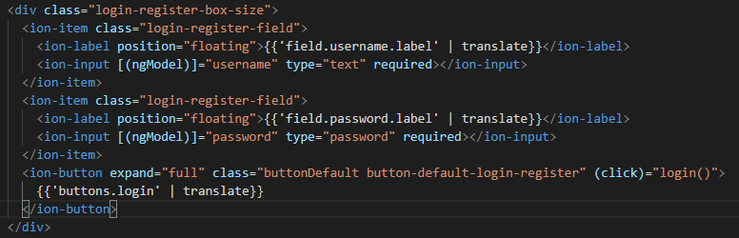
How They Works? More Programmatically (1)
Example : Login Proccess
Login.page.html

Slide 31
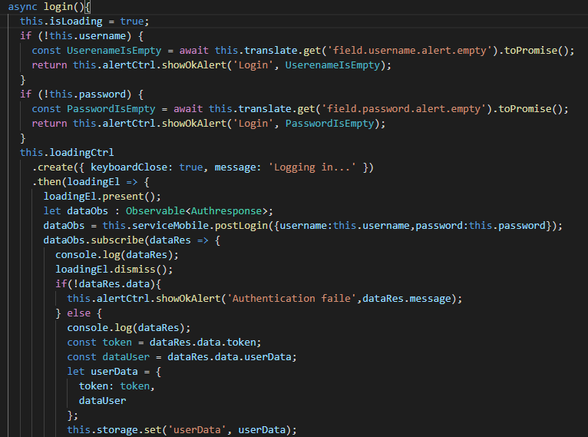
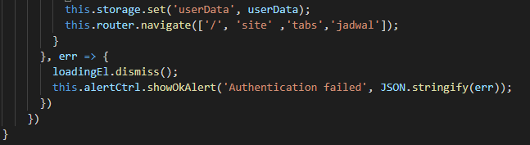
How They Works? More Programmatically (2)
Example : Login Proccess
Login.page.ts
Login.page.ts

Slide 32

How They Works? More Programmatically (3)
Example : Login Proccess
auth.service.ts

Slide 33
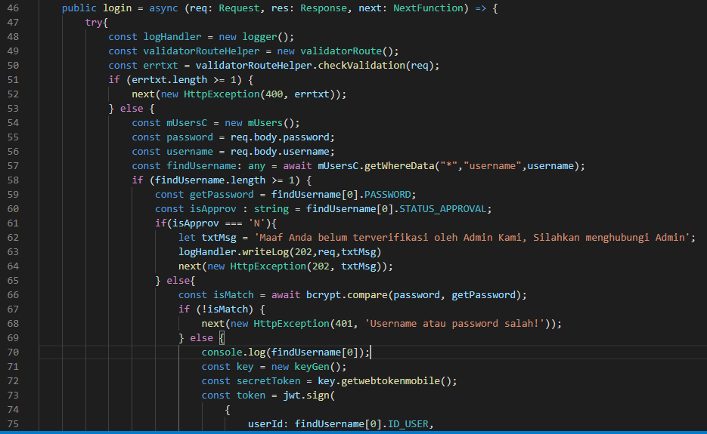
How They Works? More Programmatically (4.1)
Example : Login Proccess
siteController.ts

Slide 34
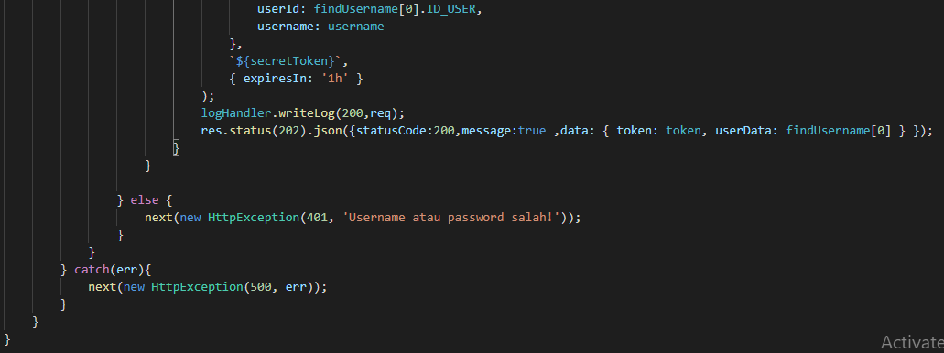
How They Works? More Programmatically (4.2)
Example : Login Proccess
siteController.ts

Slide 35
How They Works? More Programmatically (4.2)
Example : Login Proccess
siteController.ts

Slide 36
before we go future
Tugas
1. Tuangkan Ide kira-kira aplikasi apa yang mau anda buat beserta konsepnya di words
2. kita diskusikan

Slide 37
Done week 1

